Slide 1

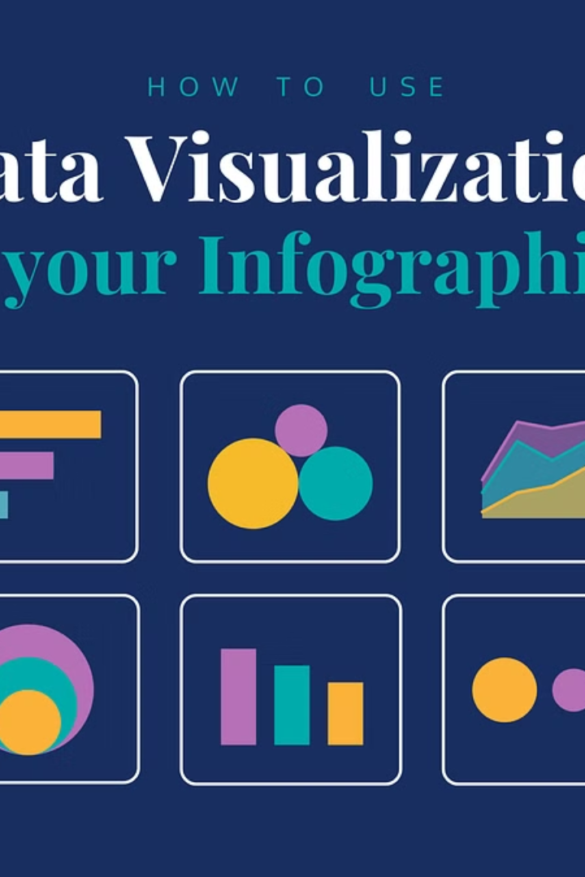
Introduction to the Data Visualization Project
This project focuses on visualizing data collected from a temperature sensor using the Thingspeak server and NodeMCU. The visualization will provide insights into the variation of temperature over time.
by :-Shivam Kumar 20201ise0080,
Chandana M 20201ise0090

Slide 2
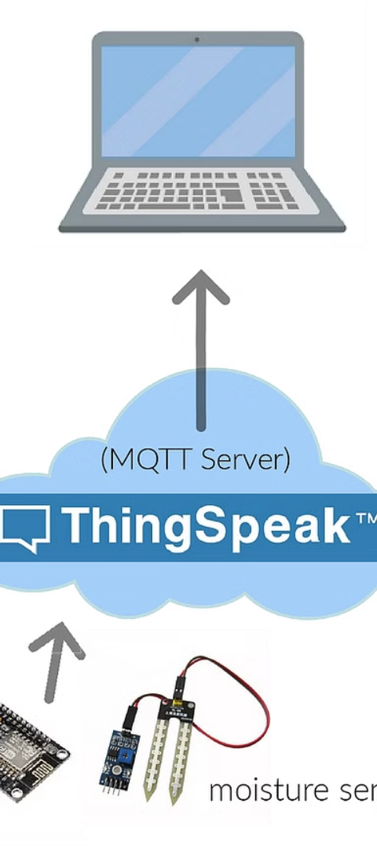
Overview of Thingspeak Server
1
Real-time Data Storage
Thingspeak serves as a platform for real-time storage of temperature data from the NodeMCU.
2
Automated Analysis
It automates the analysis of collected data and facilitates seamless integration with other systems.
3
Data Visualization
It offers built-in tools to create informative visualizations for the collected data.

Slide 3
Introduction to NodeMCU
Data Collection
Internet Connectivity
Hardware Integration
NodeMCU is utilized to collect real-time temperature data from the MAX6675 sensor.
It provides Wi-Fi connectivity, enabling seamless transfer of data to the Thingspeak server.
It offers GPIO support, making it compatible with a wide range of sensors and devices.

Slide 4
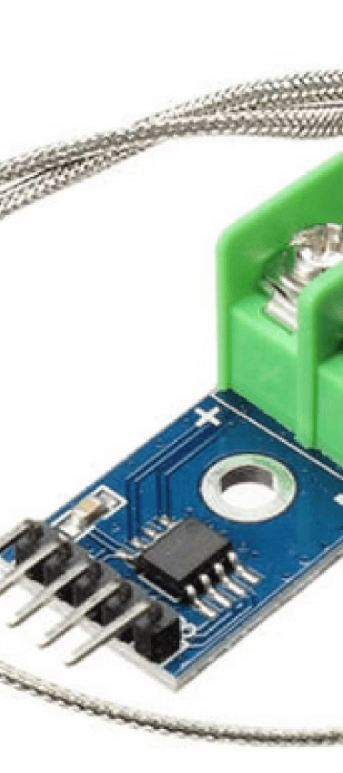
Explaining the MAX6675 Temperature Sensor
1
Precision Temperature Reading
2
Digital Output
It has a digital output interface, making it compatible with microcontrollers like NodeMCU.
The MAX6675 sensor provides accurate and reliable temperature readings in real time.
3
High Temperature Range
Capable of measuring temperatures in a wide range, making it suitable for various applications.

Slide 5



Data Usage in Vending Machine Automation
Optimized Inventory
Automated Adjustments
Enhanced Efficiency
The collected data optimizes vending machine inventory by ensuring timely restocking.
Improves overall operational efficiency by preventing stockouts and reducing energy consumption.
It facilitates automatic adjustments of cooling systems based on temperature fluctuations.

Slide 6
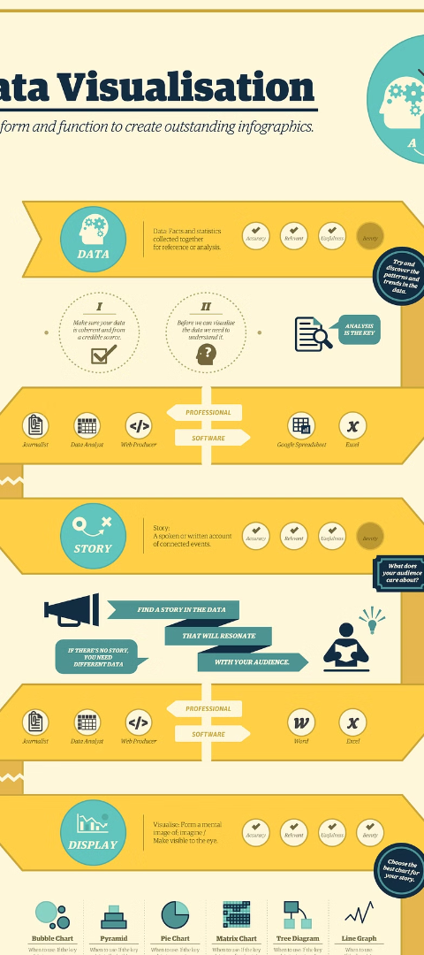



Demonstration of Data Visualization Process
Collecting Data
Data from the temperature sensor is collected and transmitted to Thingspeak server.
Analysis and Visualization
The collected data is analyzed and visualized to display temperature trends and patterns.
Integration with Automation
Integrated with the vending machine automation system to influence operational decisions.

Slide 7
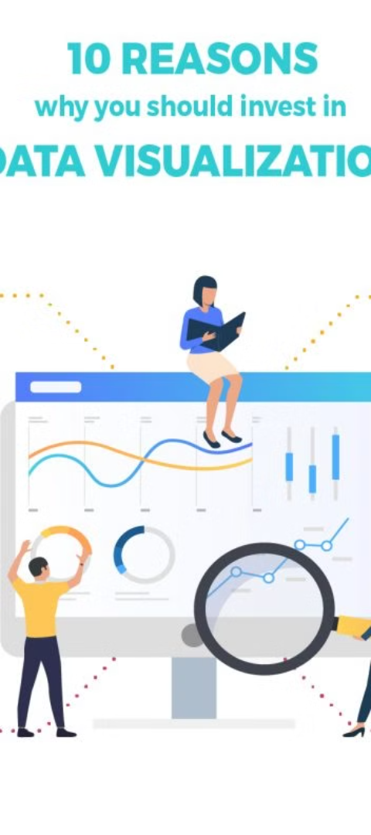
Benefits of Data Visualization in Vending Machine Automation
Decision-Making Insights
Operational Optimization
Visualizations provide insights for making informed decisions related to vending machine operations.
Helps optimize inventory management and energy usage based on visualized data.
Performance Monitoring
Enables monitoring of temperature trends and machine performance for proactive maintenance.

Slide 8
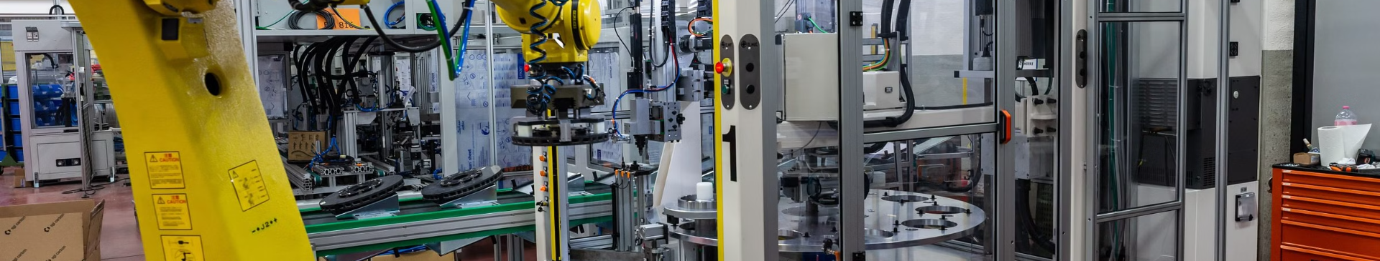
Conclusion and Next Steps
Utilizing data visualization from the Thingspeak server combined with NodeMCU and the MAX6675 temperature sensor provides a comprehensive solution for vending machine automation. The rich insights obtained from visualized data present a significant advantage in optimizing vending operations and improving efficiency. The next steps involve further enhancing the automation system to incorporate additional sensory data for broader insights and automation capabilities.

Slide 9
THANK YOU

